Slide 1

Overview of Modeling and Process Monitoring for Additive Manufacturing at MOEMS Laboratory
Distinguished Professor
Yu-Lung Lo (羅裕龍)
National Cheng Kung University
Department of Mechanical Engineering
Micro-opto Electronics Sensors Laboratory
Tainan, Taiwan

Slide 2
OUTLINE
Overview of Research Direction in 3D SLM Lab.
Our Methodology and What We’ve Done for
SLM in modeling and monitoring
3. Novelties and Research Results

Slide 3
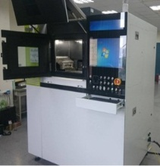
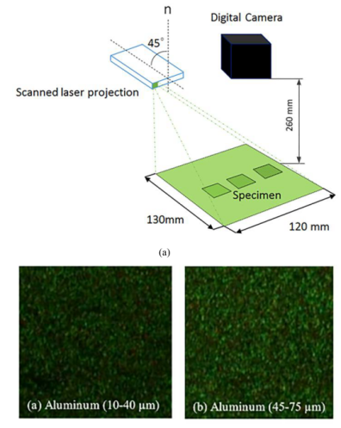
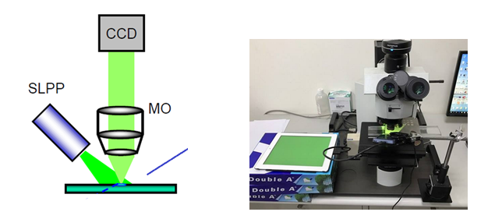
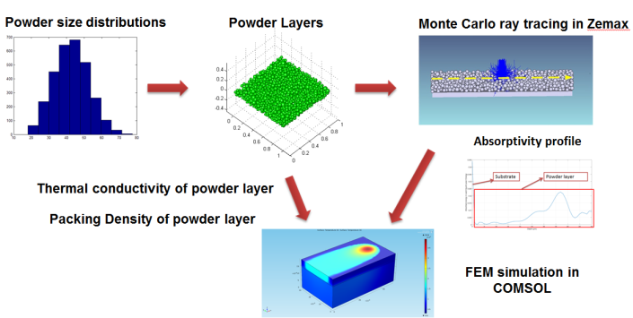
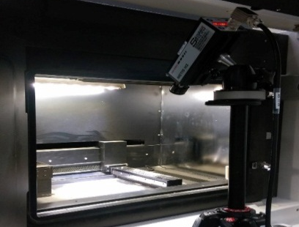
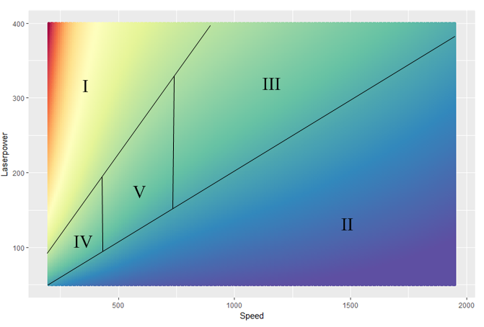
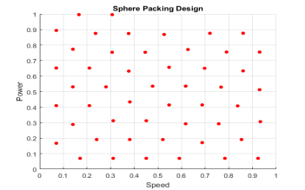
Our Methodology in SLM system
Scattering Effects of Powder Layer With Different Size Distributions
SLM
In-House Device for Quantify Surface Roughness of Single Scan Track
Materials:
SS316L
Mg and Mg Alloy
Ti6Al4V, Nickel 718 Alloy
Temperature Measurement System
Surrogates Modeling for ultrafast prediction
Simulation Model

Slide 4
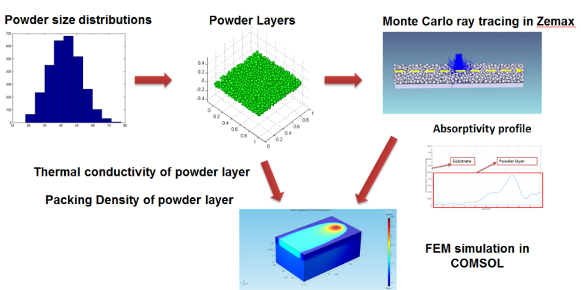
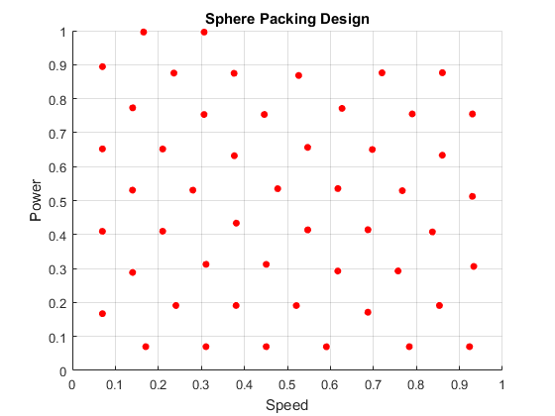
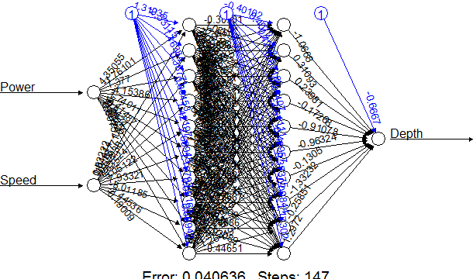
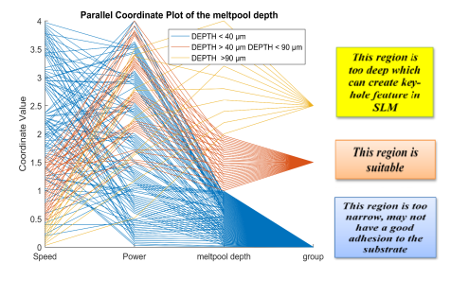
FEM and Surrogates Modeling for SS316L
We built up FEM simulation and Surrogates Modeling for ultrafast generating processing maps in SLM system using SS316L
10000 Data Points for 1 minutes in normal laptop

Slide 5
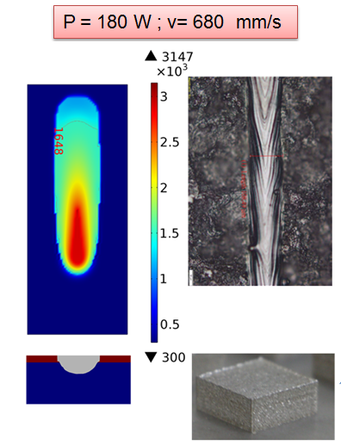
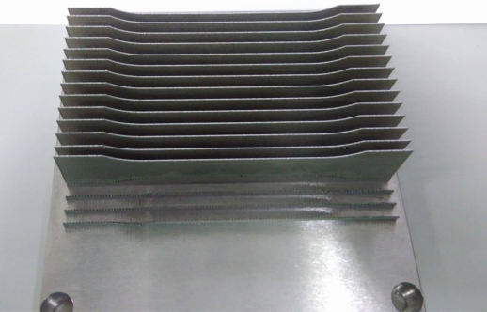
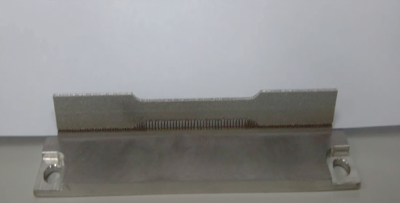
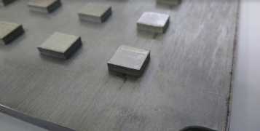
Optimum Processing Parameters for SS316L
Cross section of sample
Void
Density = 99.97 %

Slide 6
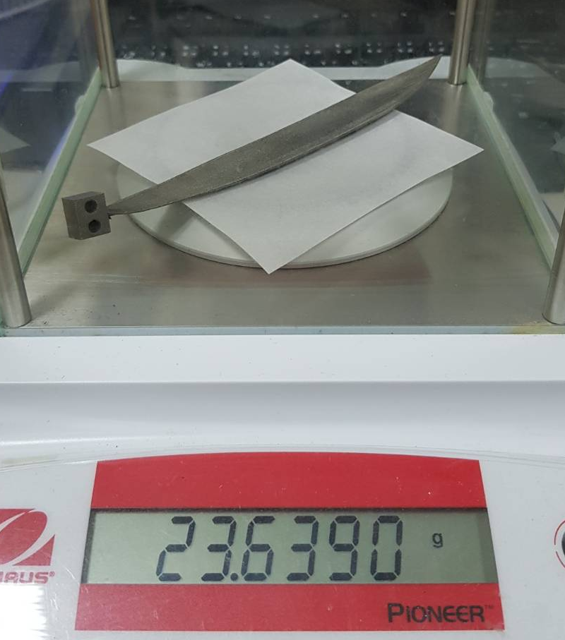
Research Results

Slide 7
Research Results
Awards about 3D AM:
Second Prize in Chinese Engineering Competition, 2016.
Silver Medal in Spintech (旭泰科技論文獎) Thesis Awards, 2017.
Related Paper publications:
Hong-Chuong Tran, *Yu-Lung Lo, and Min-Hao Huang, "Analysis of Scattering and Absorption Characteristics of Metal Powder Layer for Selective Laser Sintering,“ Published in IEEE/ASME Transactions on Mechatronics (2017) (Ranking 1/44 in manufacturing field, Impact factor: 4.357)
Hong-Chuong Tran and *Yu-Lung Lo, “Heat Transfer Simulation of Selective Laser Melting Based on Volumetric Heat Source with Powder Size Consideration," Published in the Journal of Material Processing Technology (2018) (Ranking 8/44 in manufacturing field, Impact factor: 3.147)
Patents: 3 Taiwan and 2 American Patents related to Laser Scanner/Simulation in Raining Model/Pyrometer for Melt Pool
Keynote Speaker, ICEM 2107 in Indonesia/AMRMT 2018 in Shanghai China
Keynote Speaker, ICMMT 2018 in Russia.

Slide 8

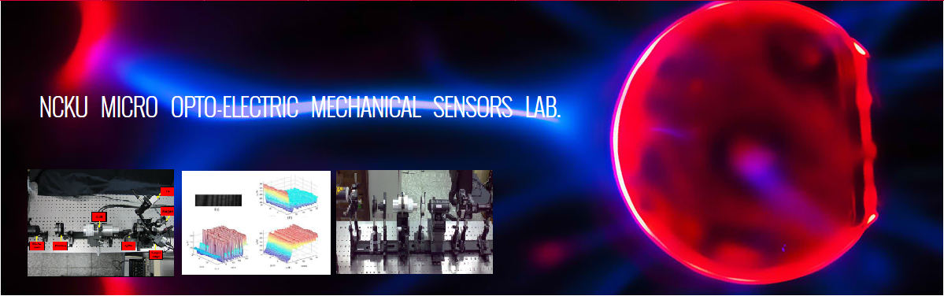
Acknowledgment
We would like to thank for the research funding from
南科管理局

